Slide 1


Dashboards Made Fun: A Beginner’s Guide to Plotly Dash
Athul Jose P
SCALE Lab, ESIC, EECS, WSU

Slide 2


Contents
WSU
Introduction
Plotly Dash
Demo
Conclusion

Slide 3

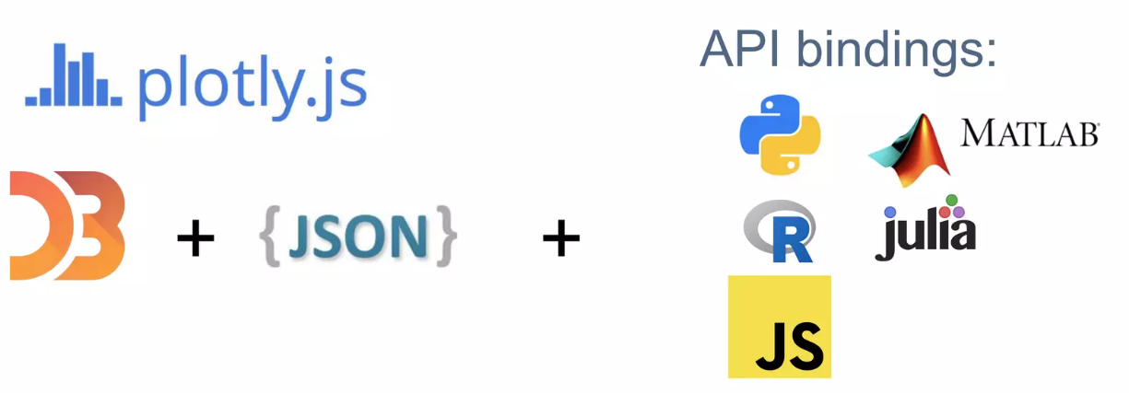
Introduction
WSU
Build interactive data visualizations for the web
In pure python – no HTML/JavaScript required
Open source library

Slide 4


Plotly Dash
WSU
Plotly.js
Based on D3.js
Dash Components
All normal HTML components in Dash
Build on top of React
Plotly Server
Flask based
Stateless

Slide 5

DEMO
WSU

Slide 6

Conclusion
WSU
Plotly Dash simplifies interactive data visualization.
It offers a user-friendly alternative to conventional HTML and JavaScript methods.
With Plotly Dash, creating dynamic and engaging data visualizations is made significantly easier.

Slide 7

References
WSU
https://dash.plotly.com/
https://github.com/athuljosep/plotly-works

Slide 8

WSU
Thank You
Questions?

